Slide 1
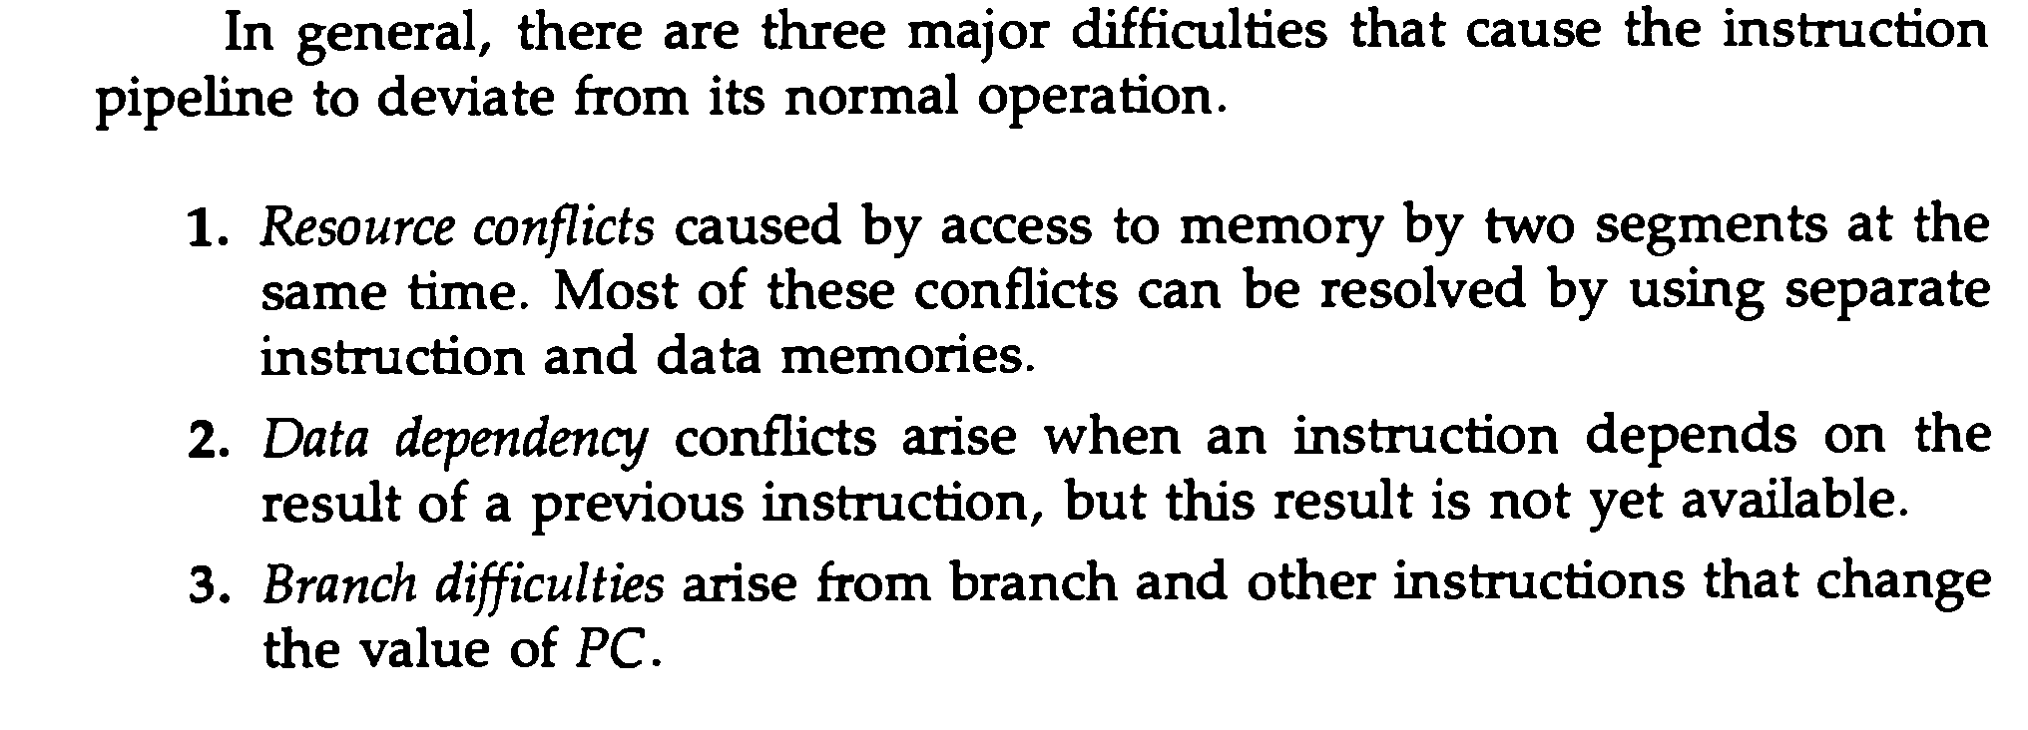
CONFLICTS OF INSTRUCTION PIPELINE
Based on M. Morris Mano “Computer System Architecture”--Assist. Lecturer Ahmed Salah Hameed

Slide 2
DATA DEPENDENCY
Based on M. Morris Mano “Computer System Architecture”--Assist. Lecturer Ahmed Salah Hameed

Slide 3
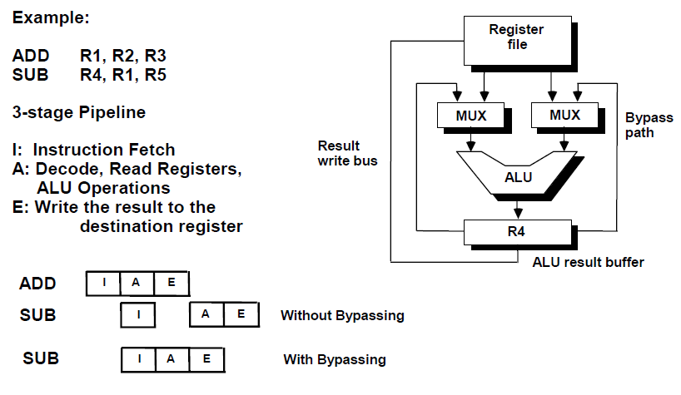
OPERAND FORWARDING
Based on M. Morris Mano “Computer System Architecture”--Assist. Lecturer Ahmed Salah Hameed

Slide 4
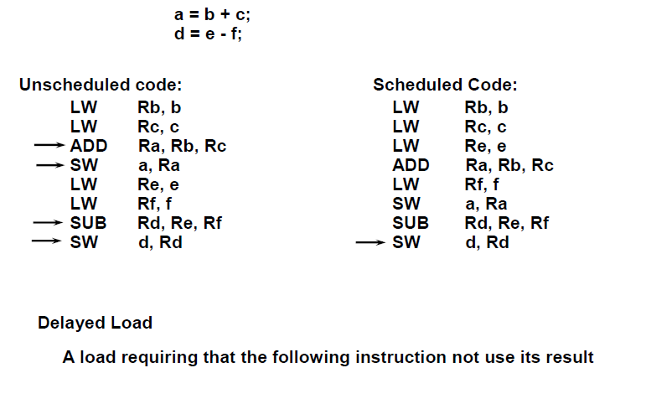
DELAYED LOAD
Based on M. Morris Mano “Computer System Architecture”--Assist. Lecturer Ahmed Salah Hameed

Slide 5
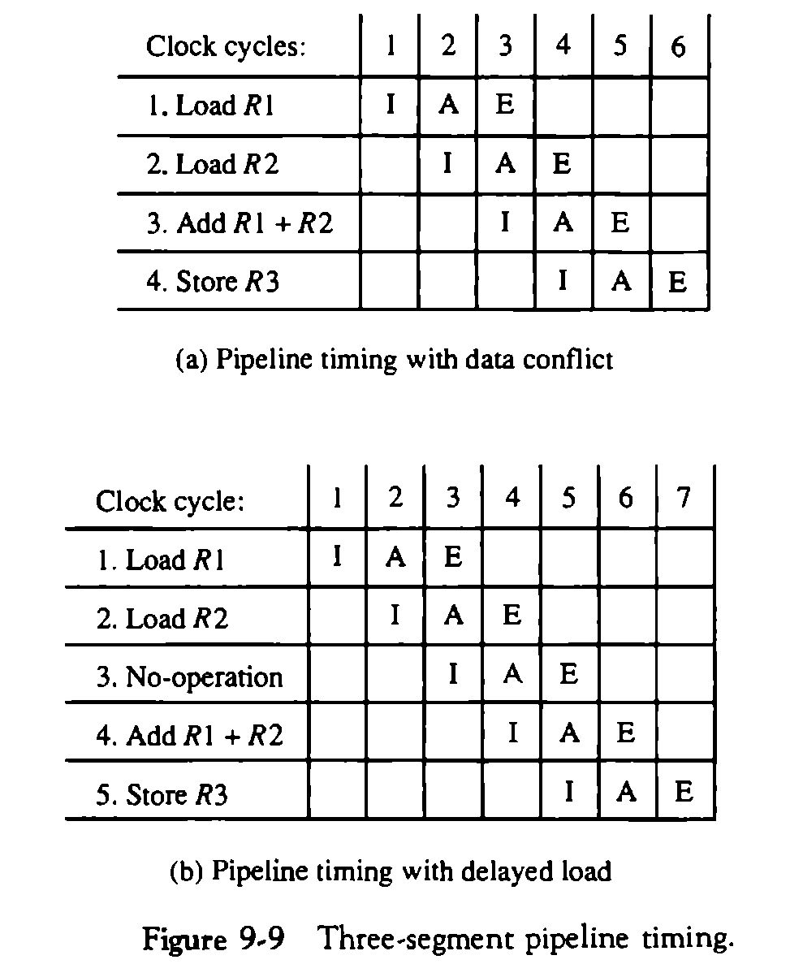
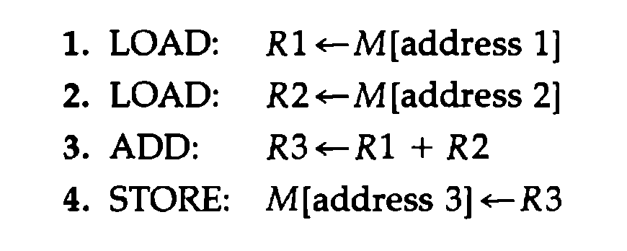
DELAYED LOAD
Based on M. Morris Mano “Computer System Architecture”--Assist. Lecturer Ahmed Salah Hameed

Slide 6
HANDLING OF BRANCH INSTRUCTIONS
Based on M. Morris Mano “Computer System Architecture”--Assist. Lecturer Ahmed Salah Hameed

Slide 7
HANDLING OF BRANCH INSTRUCTIONS
Prefetch the target instruction
Instruction in addition to the instruction following the branch. Both are saved until the branch is executed.
The control chooses the instruction stream of the correct program flow and discard the other one.
Branch Target Buffer or BTB
The BTB is an associative memory included in the fetch segment of the pipeline.
Entry: Store the address of a previously executed branch instruction, the target instruction for that branch, and the next few instructions after the branch target instruction.
When fetching and decoding instruction, it searches the BTB for the address of the instruction:
If it is in the BTB, fetch it from the BTB.
If the instruction is not in the BTB, fetch it from memory and update the BTB.
The advantage of this scheme is that branch instructions that have occurred previously are readily available in the pipeline without interruption.
Based on M. Morris Mano “Computer System Architecture”--Assist. Lecturer Ahmed Salah Hameed

Slide 8
HANDLING OF BRANCH INSTRUCTIONS
The loop buffer
This is a small very high speed register file maintained by the instruction fetch segment of the pipeline.
The program loop can be executed directly without having to access memory until the loop mode is removed by the final branching out.
Branch prediction
A pipeline with branch prediction uses some additional logic to guess the outcome of a conditional branch instruction before it is executed.
The pipeline then begins prefetching the instruction stream from the predicted path.
A correct prediction eliminates the wasted time caused by branch penalties.
Delayed branch
The compiler detects the branch instructions and rearranges the machine language code sequence by inserting useful instructions that keep the pipeline operating without interruptions.
An example of delayed branch is the insertion of a no-operation instruction after a branch instruction.
Based on M. Morris Mano “Computer System Architecture”--Assist. Lecturer Ahmed Salah Hameed

Slide 9
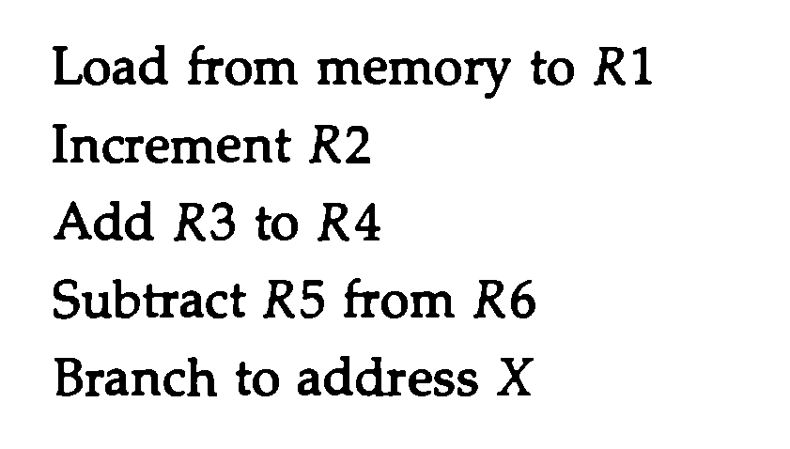
EXAMPLE OF DELAYED BRANCH
Based on M. Morris Mano “Computer System Architecture”--Assist. Lecturer Ahmed Salah Hameed

Slide 10
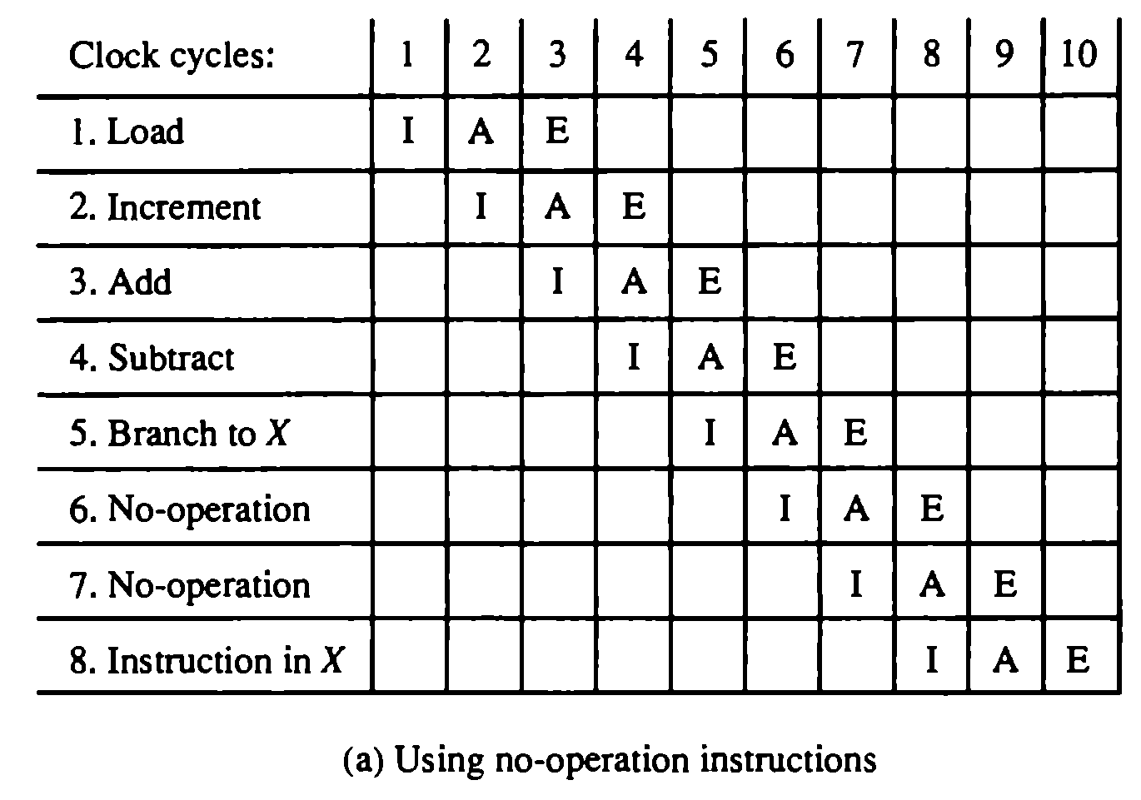
EXAMPLE OF DELAYED BRANCH
Based on M. Morris Mano “Computer System Architecture”--Assist. Lecturer Ahmed Salah Hameed

Slide 11
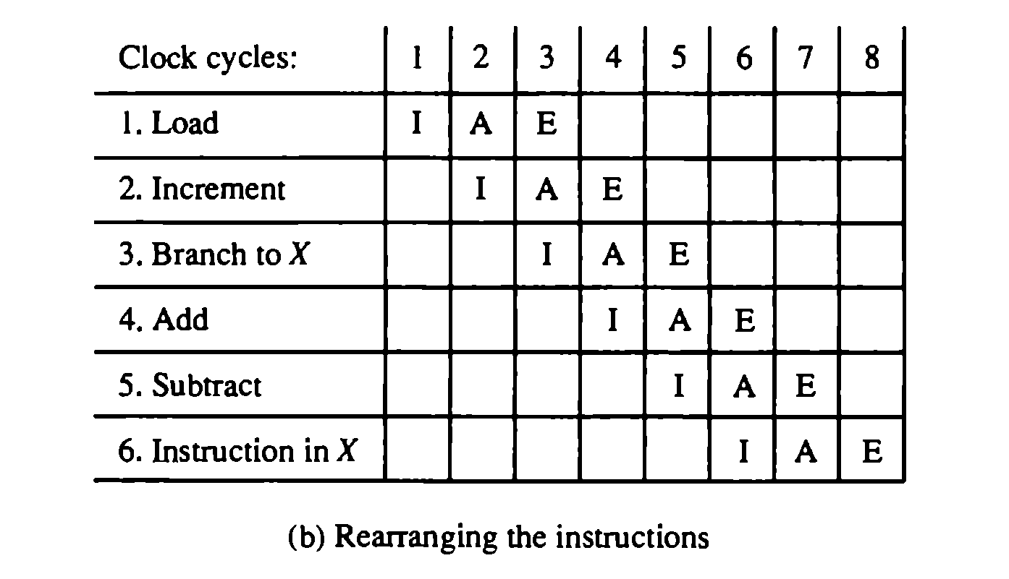
EXAMPLE OF DELAYED BRANCH
Based on M. Morris Mano “Computer System Architecture”--Assist. Lecturer Ahmed Salah Hameed

